Slide 1
Internet of Things & Its Applications
Dr. Phanindra Thota

Slide 2
Unit-2
Connectivity &
Communication Technologies

Slide 3
Connectivity & Communication Technologies
Wireless Technologies for IoT
IEEE 802.15.4 (LR-WPAN)
Zigbee
WirelessHART
RFID
NFC
Z-Wave
Weightless (LPWAN)
LoRa (LoRaWAN) (LPWAN)
Wi-Fi (WLAN)
BLE (LR-WPAN)
IP Based Protocols for IoT
IPv6
6LowPAN
MQTT
CoAP
AMQP
SOAP
REST

Slide 4
LR-WPAN : (Low-Rate Wireless Personal Area Network)
IEEE 802.15.4
Zigbee
WirelessHART
BLE
WLAN: (Wireless Local Area Network)
WiFi
LPWAN : (Low-Power Wide-Area Network)
Weightless
LoRa

Slide 5
Connectivity & Communication Technologies
Wireless Technologies for IoT
IEEE 802.15.4 (LR-WPAN)
Zigbee
WirelessHART
RFID
NFC
Z-Wave
Weightless (IEEE 802.22) (LPWAN)
LoRa (LoRaWAN) (LPWAN)
Wi-Fi (IEEE 802.11) (WLAN)
BLE (IEEE 802.15.1) (LR-WPAN)
IP Based Protocols for IoT
IPv6
6LowPAN
MQTT
CoAP
AMPQ
SOAP
REST

Slide 6
 | LR-WPAN | LPWAN | LoRa
Range | Short-range (10-100 meters). | Long-range (up to tens of kilometers). | Long-range (up to 10 kilometers in rural areas).
Data Rate | Moderate (up to 250 kbps). | Low (varies by technology, typically a few bps to kbps). | Low (0.3 kbps to 50 kbps).
Frequency Bands | 2.4 GHz, with some sub-GHz options. | Sub-GHz ISM bands or licensed bands. | Sub-GHz ISM bands.
Power Consumption | Low | Ultra-low | Ultra-low
Applications | Home automation, short-range wireless sensor networks. | Smart cities, agriculture, large-scale IoT deployments. | Long-range IoT applications like smart agriculture, environmental monitoring, and asset tracking

Slide 7
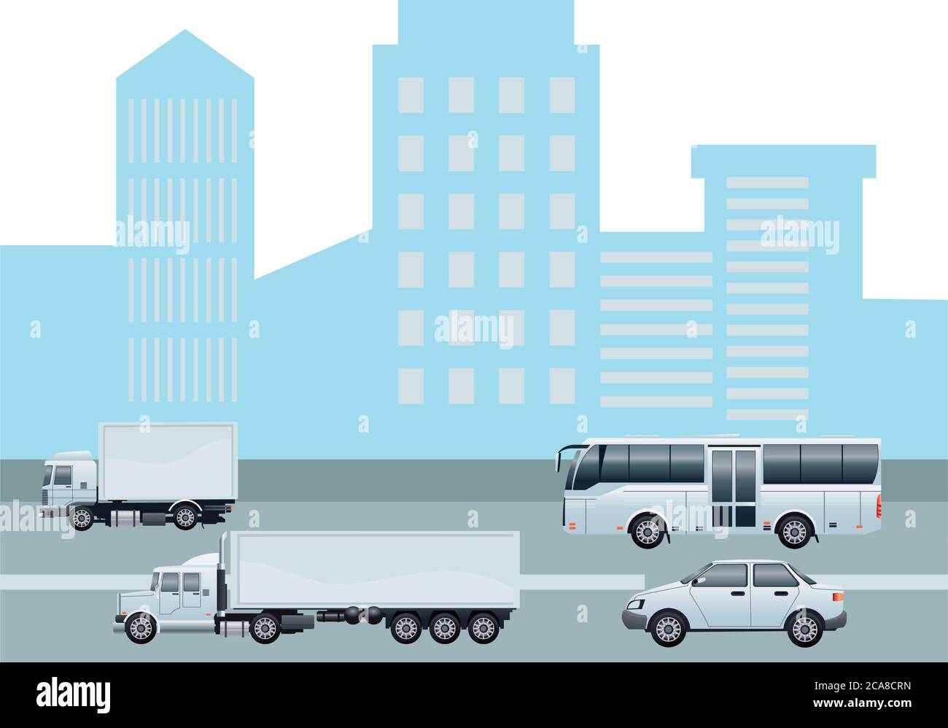
Connectivity Technologies
These technologies are primarily concerned with establishing and maintaining the infrastructure that allows devices and systems to connect to each other. This includes physical and wireless connections.
Examples:
Networking Hardware: Routers, switches, and hubs.
Protocols and Standards: Ethernet, Wi-Fi, Bluetooth.
Infrastructure: Fiber optics, satellite systems, cellular networks.
Communication Technologies
These technologies are centered around the methods and protocols used for the exchange of information between devices, people, or systems. They often leverage the infrastructure provided by connectivity technologies.
Examples:
Messaging Systems: Email, SMS, instant messaging platforms.
Voice and Video Communication: VoIP (Voice over IP), video conferencing tools.
Data Transmission Protocols: HTTP, FTP, MQTT (for IoT).

Slide 9
Full Function Device
Devices in IEEE 802.15.4
Reduced Function Device
Star Topology
Network Topologies
Peer-to-Peer (Mesh) Topology
IEEE 802.15.4
Cluster-Tree Topology
Personal Area Network (PAN) Coordinator
Network Components
Coordinator
End Devices
Beacon-Enabled Mode
Network Operation Modes
Non-Beacon-Enabled Mode

Slide 11
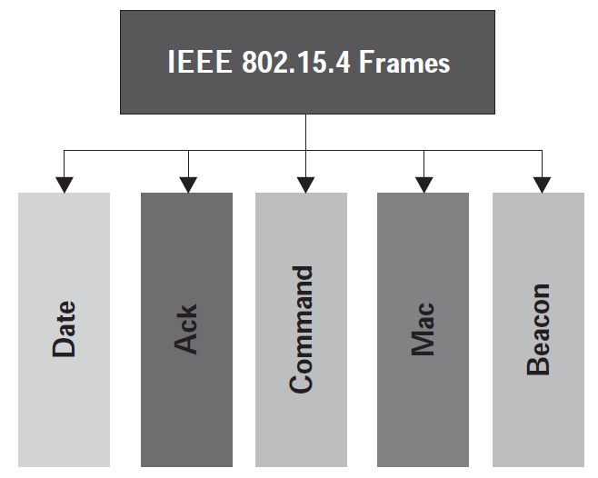
IEEE 802.15.4 defines the frame structures used for communication in low-rate wireless personal area networks (LR-WPANs). These frames carry data, control information, and management messages between devices within the network. There are several types of frames in IEEE 802.15.4, each serving a specific purpose.
DATA

Slide 12
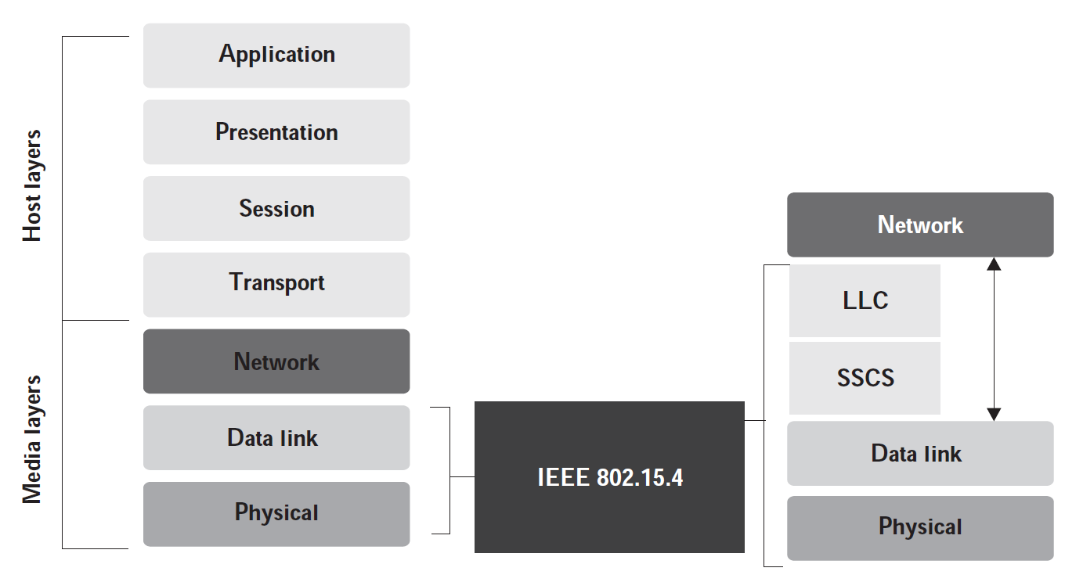
The operational part of IEEE 802.15.4's protocol stack in comparison to the OSI stack

Slide 13
The IEEE 802.15.4 standard represents the most popular standard for for Low data Rate Wireless Personal Area Networks (LR-WPAN).
This standard uses only the first two layers physical and data link for operation along with two new layers above it:
1) Logical Link Control (LLC)
2) Service-Specific Convergence Sublayer (SSCS).
These additional layers help in the communication of the lower layers with the upper layer
Direct Sequence Spread Spectrum (DSSS) modulation technique is used in IEEE 802.15.4 for communication purposes, enabling a wider bandwidth of operation with enhanced security by the modulating pseudo-random noise signal.

Slide 14
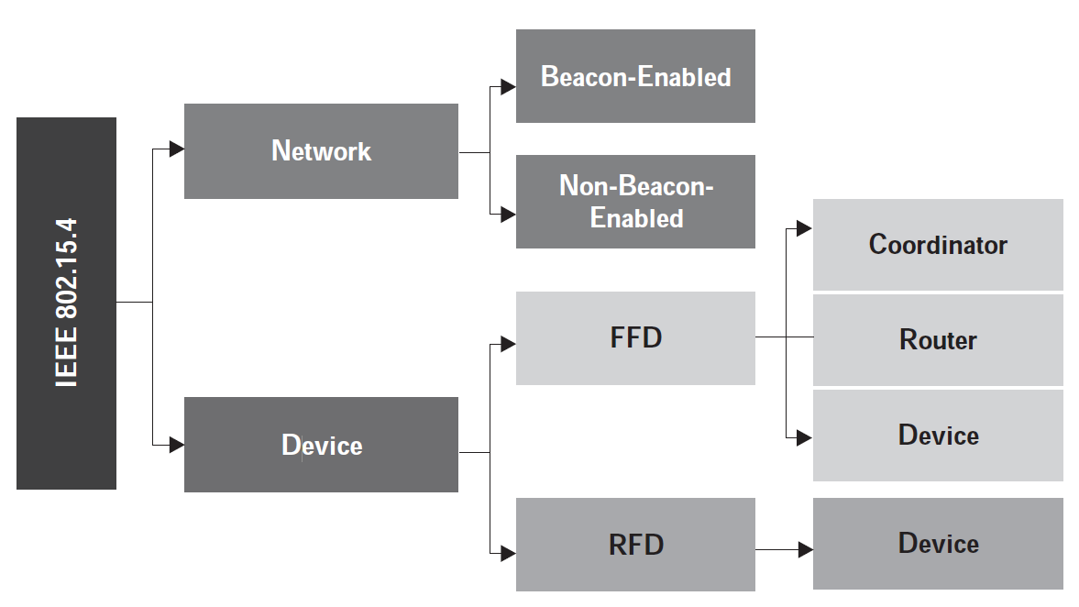
The various device and network types supported in the IEEE 802.15.4 standard

Slide 15
The IEEE 802.15.4 standard supports two network types:
Beacon-enabled networks (Synchronous Communication)
Non-beacon-enabled networks ( Asynchronous Communication)
1) Beacon-enabled networks
In this mode, a coordinator node periodically sends out beacon frames to synchronize the network and manage communication between devices. The beacons allow devices to know when to transmit or receive data, thus conserving energy by entering low-power modes between beacon intervals.
The communication is organized into a superframe structure, which consists of an active period (when devices can communicate) and an optional inactive period (when devices can sleep to save power).
2) Non-beacon-enabled networks
In this mode, there are no periodic beacon frames. Devices can transmit data at any time by using a Carrier Sense Multiple Access with Collision Avoidance (CSMA/CA) mechanism. This mode is less structured and may be easier to implement but is typically less energy-efficient than the beacon-enabled mode.

Slide 16
The IEEE 802.15.4 standard supports two types of devices
Full Function Devices (FFD)
Reduced Function Device (RFD)

Slide 17
Full Function Device (FFD)
Capabilities:
Network Roles: FFDs can operate in any of the three network roles:
1) Coordinator,
2) PAN Coordinator,
3) End Device.
1) Coordinator: Manages the network, including beacon transmission (in beacon-enabled mode)
and device association.
2) PAN Coordinator: A special type of Coordinator that initializes the network and acts as the central controller.
3) End Device: Participates in the network but doesn't have routing capabilities.
Communication: FFDs can communicate with any other device in the network, whether it's an FFD or RFD.
Routing: FFDs can forward messages between devices, acting as routers in a mesh or tree network topology.
Energy Consumption: Typically higher than RFDs due to their advanced capabilities and the possibility of remaining active for extended periods.
Use Cases: FFDs are used in scenarios requiring complex networking functions, such as routers in a mesh network or coordinators managing network communication.

Slide 18
Reduced Function Device (RFD)
Capabilities
Network Roles: RFDs are limited to being End Devices. They do not have the capability to act as
Coordinators or routers.
Communication: RFDs typically communicate with a single FFD (often the network Coordinator or a router) and cannot directly communicate with other RFDs or serve as routers.
Simplicity: RFDs are designed to be simple, low-cost devices with minimal functionality. They often
operate in low-power mode and wake up only when necessary to send or receive data.
Energy Consumption: RFDs are optimized for low power consumption, making them suitable for
battery-operated devices that need to last a long time without recharging
Use Cases: RFDs are ideal for simple sensing or monitoring tasks where advanced networking capabilities are not needed, such as in basic sensor nodes or light switches.

Slide 19
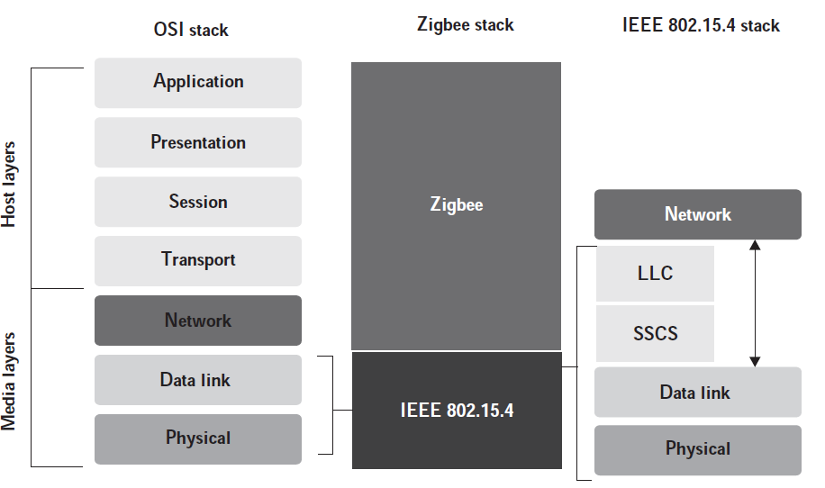
The PHY and MAC layers of the
IEEE 802.15.4 standard
are used to build the
protocol for Zigbee architecture.
Zigbee handles two-way data transfer using two operational modes:
1) Non beacon mode
2) Beacon mode
The Zigbee protocol stack in comparison to the OSI stack

Slide 20
Physical Layer: This layer is tasked with transmitting and receiving signals, and performing modulation and demodulation operations on them, respectively. The Zigbee physical layer consists of 3 bands made up of 27 channels: the 2.4 GHz band has 16 channels at 250 kbps the 868.3 MHz has one channel at 20 kbps; and the 902-928 MHz has ten channels at 40 kbps.
MAC Layer: This layer ensures channel access and reliability of data transmission. CSMA-CA is used for channel access and intra-channel interference avoidance. This layer handles communication synchronization using beacon frames.
Network Layer: This layer handles operations such as setting up the network, connecting and disconnecting the devices, configuring the devices, and routing.
Application Support Sub-Layer: This layer handles the interfacing services, control services, bridge between network and other layers, and enables the necessary services to interface with the lower layers for Zigbee device object (ZDO) and Zigbee application objects (ZAO). This layer is primarily tasked with data management services and is responsible for service-based device matching.
Application Framework: Two types of data services are provided by the application framework: provision of a key-value pair and generation of generic messages. A key-value pair is used for getting attributes within the application objects, whereas a generic message is a developer-defined structure.

Slide 21
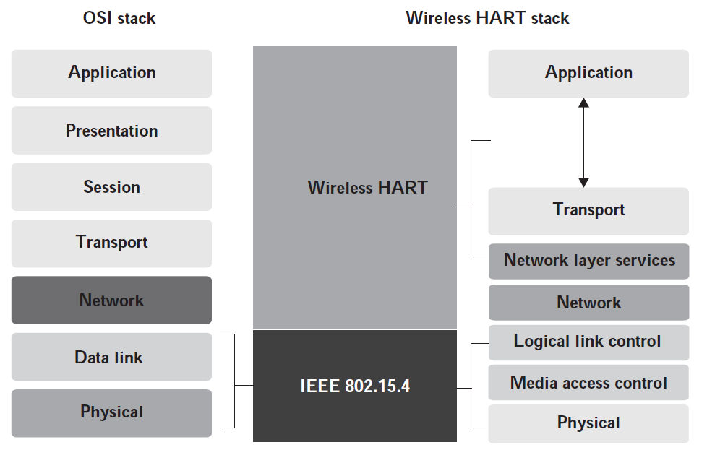
The WirelessHART protocol stack in comparison to the OSI stack

Slide 22
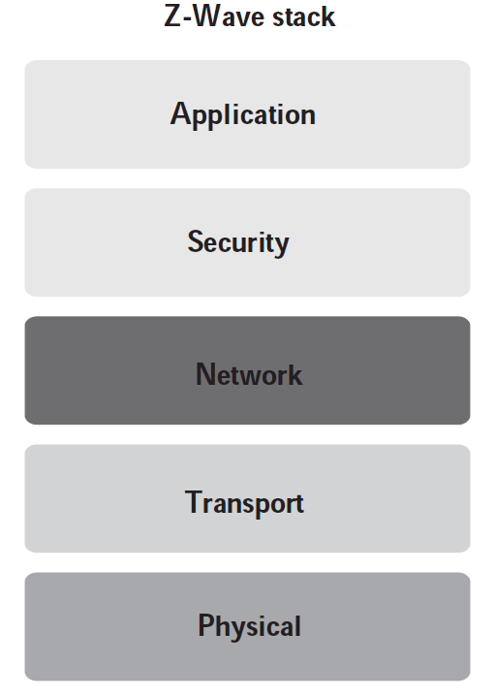
The Z-Wave protocol stack

Slide 23
Zigbee: Primarily used for home automation, smart lighting, and other consumer electronics.
Mesh Networking: Devices can communicate with each other, extending the network range.
Scalability: Supports large networks with up to 65,000 devices.
Z-Wave : Designed specifically for residential home automation.
Mesh Networking: Similar to Zigbee, Z-Wave devices create a mesh network, allowing signals to be
relayed through other devices.
Scalability: Supports up to 232 devices in a network, typically sufficient for most residential setups.
Wireless Hart : Tailored for industrial automation and process control in harsh environments.
Mesh Networking: Uses a self-organizing and self-healing mesh network for multiple communication paths, ensuring high reliability.
Scalability: Typically used in smaller, highly reliable networks compared to Zigbee, but optimized for industrial environments.

Slide 24
Zigbee
Z-Wave
Zigbee communication protocol is an open standard protocol used on mesh networks for wireless communication between smart devices at home, offices, hospitals, etc. This means that with the Zigbee protocol, signals can hop from one Zigbee device to another in an open structure without connecting each device to a central hub (Wifi).
The Zigbee protocol is built on IEEE 802.15.4 protocol standard
This makes the protocol functional in many use cases like home automation, building automation, medical care, gaming, etc.
This makes the protocol functional in many use cases like home automation, building automation, medical care, gaming, etc.
Z-Wave is a close standard protocol used on mesh networks for wireless communication between intelligent devices at home, offices, and other places.
This protocol supports communication between devices in a closed network. This means that one cannot access the governing code of Z-Wave publicly
This protocol supports communication between devices in a closed network. This means that one cannot access the governing code of Z-Wave publicly.
This protocol supports communication between devices in a closed network. This means that one cannot access the governing code of Z-Wave publicly.
Notes:
open standard protocol is one that is publicly available and developed through a collaborative process.
A closed standard protocol is proprietary and owned by a specific organization or company.

Slide 25
WirelessHART
WirelessHART is a radio communications protocol that adds wireless capabilities to the HART protocol while maintaining compatibility with existing HART devices, commands, and tools.
WirelessHART utilizes a time synchronized, self-organizing, and self-healing mesh architecture.
WirelessHART supports operation in the 2.4 GHz ISM (license free) band using IEEE 802.15.4 standard radios.
In a WirelessHART network, every participating device simultaneously works as a signal source and a repeater.
Through the routing of the individual signals across the entire network, a wide network structure becomes possible.
Repeaters (routers) can be strategically placed to expand a network's reach throughout the facility or field application.

Slide 26
RFID
RFID stands for radio frequency identification.
This technology uses tags and readers for communication.
RFID tags have data encoded onto them digitally.
The RFID readers can read the values encoded in these tags without physically touching them.
RFID systems are capable of automatically categorizing objects.
Categorization tasks such as identifying tags, reading data, and feeding the read data directly into computer systems through radio waves outline the operation of RFID systems.
Typically, RFID systems are made up of three components:
1) RFID tag or smart label
2) RFID reader
3) Antenna.

Slide 27
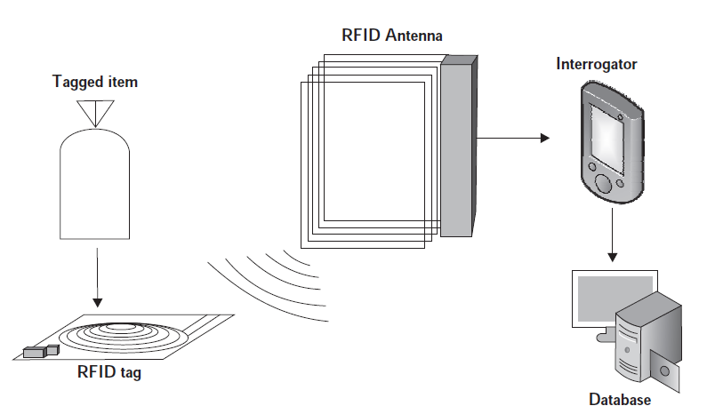

Slide 28
In RFID, the tags consist of an integrated circuit and an antenna, enclosed in a protective casing to protect from wear and tear and environmental effects.
These tags can be either active or passive.
Passive tags find common usage in a variety of applications due to its low cost; however, it has to be powered using an RFID reader before data transmission.
Active tags have their own power sources and do not need external activation by readers.
Tags are used for transmitting the data to an RFID interrogator or an RFID reader.
The radio waves are then converted to a more usable form of data by this reader.
A host computer system accesses the collected data on the reader by a communication technology such as Wi-Fi or Ethernet. The data on the host system is finally updated onto a database.

Slide 29
NFC
Near field communication (NFC) peer-to-peer (P2P) data exchange network.
Communication between NFC devices is achieved by the principle of magnetic induction, whenever the devices are brought close to one another.
NFC can also be used with other wireless technologies such as Wi-Fi after establishing and configuring the P2P network.
The communication between compatible devices requires a pair of transmitting and receiving devices.
NFC devices can be grouped into two types: 1) passive NFC and 2) active NFC
A small electric current is emitted by the NFC reader, which creates a magnetic field that acts as a bridge in the physical space between two NFC devices.
The generated EM (electromagnetic) field is converted back into electrical impulses through another coil on the client device.
Data such as identifiers, messages, currency, status, and others can be transmitted using NFCs. NFC communication and pairing are speedy due to the use of inductive coupling and the absence of manual pairing.

Slide 30
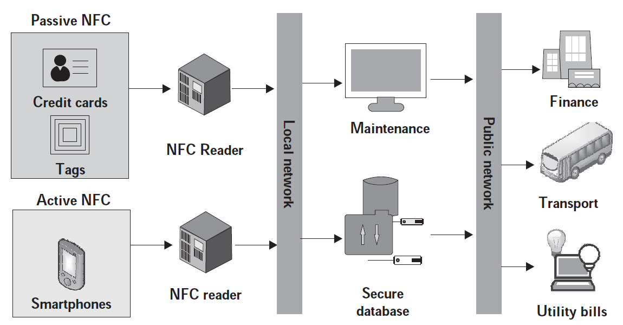

Slide 31
Passive NFC devices do not need a power source for communicating with the NFC reader. Tags and other small transmitters can act as passive NFC devices. However, passive devices cannot process information; they simply store information, which is read by an NFC reader.
Active NFC devices can communicate with active as well as passive NFC devices. Active devices are capable of reading as well as writing data to other NFC terminals or devices.
Some of the most commonly used NFC platforms are smartphones, public transport card readers, and commercial touch payment terminals.
NFC currently supports three information exchange modes:
peer-to-peer
read/write
card emulation.

Slide 32
The peer-to-peer mode is commonly used in NFC modes; it enables two NFC devices to exchange information. In the peer-to-peer mode of information exchange, the transmitting device goes active while the receiving device becomes passive. During the reverse transfer, both devices change roles.
The read/write mode of information exchange allows only one-way data transmission. An active NFC device connects to a passive device to read information from it.
Card emulation mode enables an NFC device (generally, smartphones) to act as a contactless credit card and make payments using just a simple tap on an NFC reader.

Slide 33
RFID (Radio-Frequency Identification) and NFC (Near Field Communication) are both wireless communication technologies that use radio waves to transfer data.
RFID: Uses radio waves to communicate between a tag (a small chip with an antenna) and a reader. RFID can be either passive (powered by the reader's signal) or active (powered by an internal battery).
Can operate over a wide range of distances, from a few centimeters up to several meters, depending on the frequency band and power of the reader.
Usually one-way communication, where the reader sends a signal to the tag, and the tag responds with the stored data. Some RFID systems can also support two-way communication.
NFC: A subset of RFID technology, NFC operates on a specific RFID standard (13.56 MHz) and enables two-way communication between devices. NFC is always passive, relying on close proximity between the communicating devices.
Operates at very short ranges, typically within 4 cm (1.6 inches), making it ideal for secure transactions and close-proximity data exchanges.
Two-way communication, allowing devices to both send and receive information, which is why it's used in contactless payment systems and peer-to-peer data transfers.

Slide 34
Weightless is a family of wireless communication protocols specifically designed for low-power, wide-area networks (LPWAN) in the Internet of Things (IoT). These protocols were developed to provide efficient, long-range communication with minimal power consumption, targeting large-scale IoT deployments.
Initially, three standards were released for Weightless:
Weightless N
Weightless P
Weightless W
1. Weightless-N: is an ultra-narrowband (UNB) protocol designed for one-way communication (uplink only) from devices to base stations. It is highly optimized for long-range and low-power applications.
2. Weightless-P: is a more advanced protocol compared to Weightless-N, offering bidirectional communication (both uplink and downlink). It is designed to provide better performance in terms of data rate, latency, and flexibility.
3. Weightless-W: is designed for wide-area networks, with a focus on providing flexibility in frequency band usage and data rates. It was the first Weightless protocol but has seen less adoption compared to Weightless-N and Weightless-P.

Slide 35
Weightless-N:
Uplink only (one-way).
Lowest data rate (up to 100 bps).
Lowest power consumption.
Usage: Ideal for simple, low-cost devices with limited communication needs.
Weightless-P:
Bidirectional communication.
Moderate data rate (200 bps to 100 kbps).
Slightly higher power consumption due to two-way communication.
Usage: Suitable for applications requiring two-way interaction and more complex functionality.
Weightless-W:
Bidirectional with higher data rates (1 kbps to 10 Mbps).
Operates in TV white space spectrum.
Usage: More versatile but less widely adopted compared to Weightless-N and Weightless-P.

Slide 36
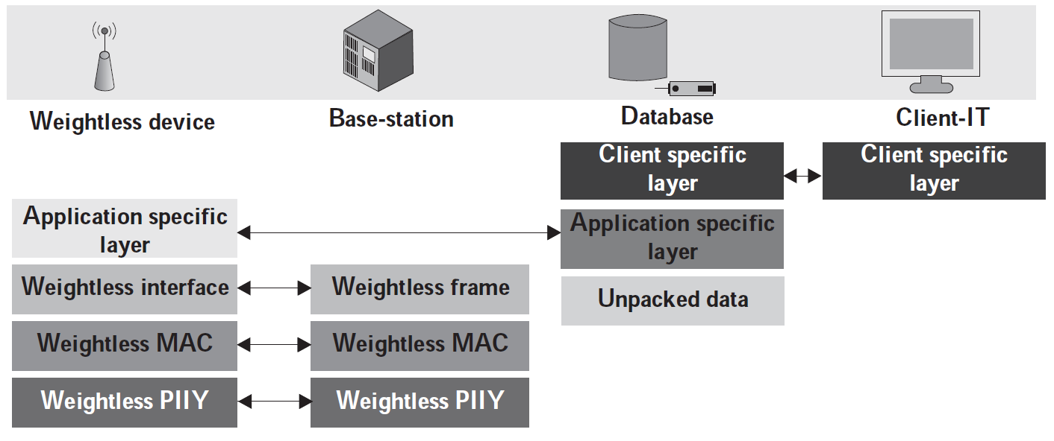
Components of the Weightless standard and its protocols

Slide 37
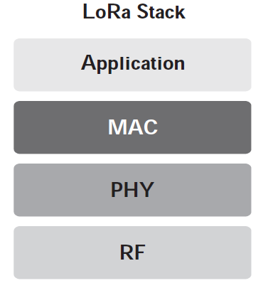
Long Range (LoRa)
LPWAN
It is specifically designed for long-range, low-power, low-data-rate communication, making it ideal for Internet of Things (IoT) applications that require devices to operate over extended distances with minimal energy consumption.
LoRa can communicate over distances ranging from a few kilometers in urban environments to over 10 kilometers in rural or open areas.
The range depends on factors such as the environment, frequency band, and network configuration.
LoRa is designed to be highly power-efficient, allowing devices to operate on battery power for several years, which is essential for IoT applications where devices are often deployed in remote or hard-to-reach areas.
Its ability to operate in unlicensed bands and support large-scale deployments makes it a popular choice for smart city infrastructure, agricultural monitoring, and various industrial applications.
LoRa protocol stack

Slide 38
LoRa is typically used in a star topology, where end devices (sensors, actuators) communicate directly with a central gateway or base station.
LoRa is made up of four crucial entities:
1) End points/nodes,
2) Gateways,
3) Network server
4) Remote computer
1) End nodes deal with all the sensing and control solutions.
2) The gateways forward messages from end nodes to a backhaul network.
* LoRa network can comprise both or either of wired and wireless technologies.
* The gateways themselves are connected to the network server utilizing IP-based connections
(either private or public).
3) LoRa network server is responsible for scheduling message acknowledgments, modifying data
rates, and removing message redundancies.
4) Remote computers have control over the end nodes and act as data sinks for data originating
from these nodes.

Slide 39
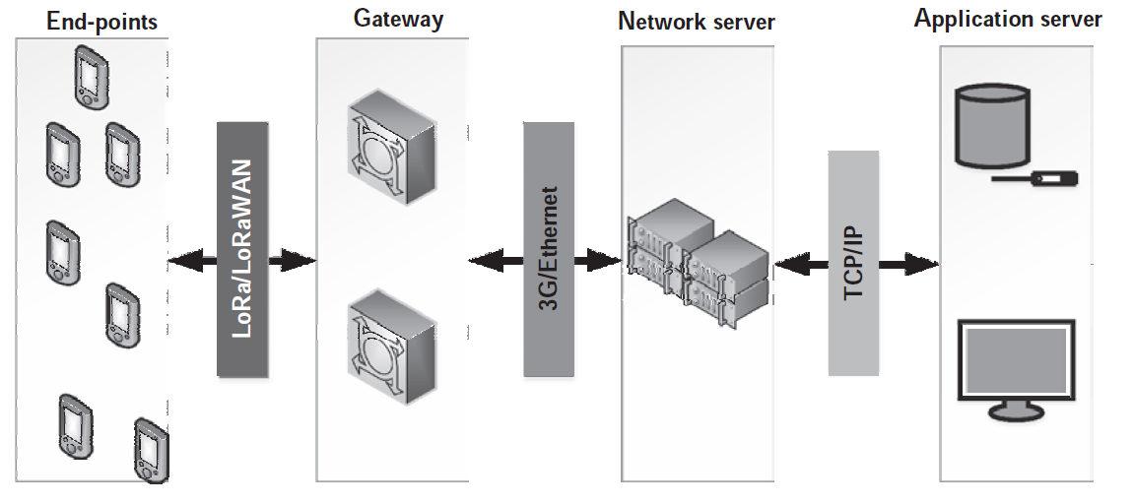
LoRa deployment and communication architecture

Slide 40
IoT communication protocols according to their usage into 6 groups:
1) Infrastructure protocols (IPv6, 6LowPAN)
(The protocols covered in this section are hugely dependent on the network and the network infrastructure for its operation.)
2) Discovery protocols
3) Data protocols (MQTT, CoAP, AMQP, REST, SOAP)
(The protocols covered in this section are directly related to access, storage, and distribution of data through the IoT network)
4) Identification protocols
5) Device management protocols
6) Semantic protocols.

Slide 41
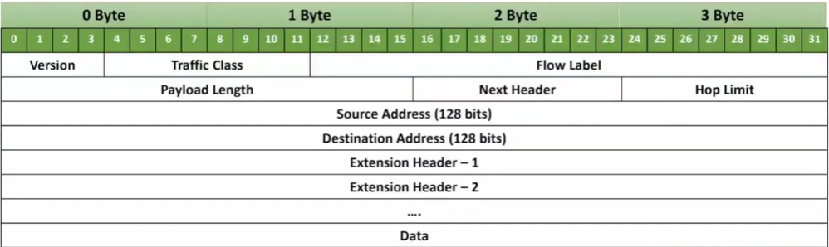
0 Byte
1 Byte
2 Byte
3 Byte
4
8
20 bits
16 bits
8
8
Fixed
Header

Slide 42
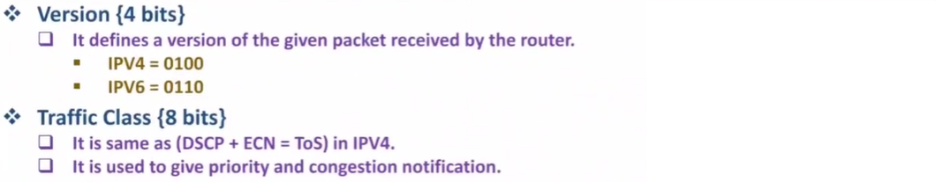
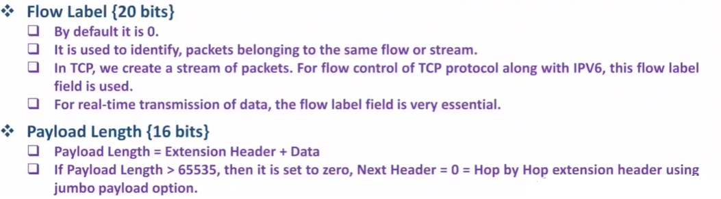


Slide 43
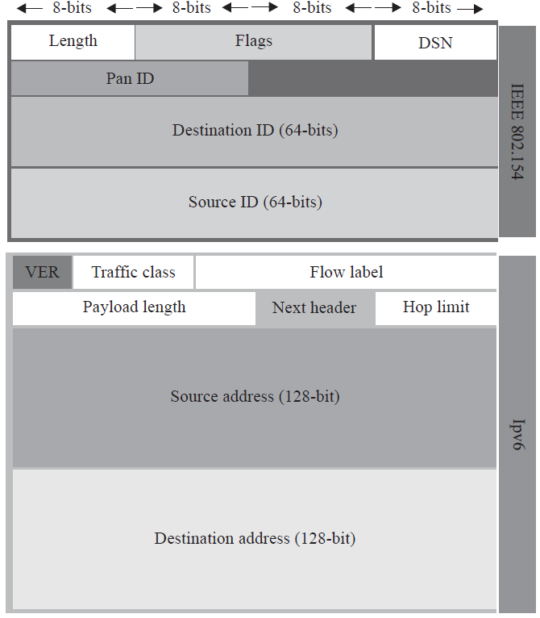
6LoWPAN packet structure

Slide 44
MQTT (Message Queue Telemetry Transport)
MQTT is a simple, lightweight publish subscribe protocol, designed mainly for messaging in constrained devices and networks.
MQTT is built upon the principles of hierarchical topics and works on TCP for communication over the network.
Quality of Service (QoS) Levels:
QoS 0: "At most once" delivery, where messages are delivered according to the best efforts of the operating environment. No acknowledgment.
QoS 1: "At least once" delivery, ensuring that a message is delivered at least once to the receiver. Acknowledgment is required.
QoS 2: "Exactly once" delivery, ensuring that the message is received only once by the intended recipients. This is the highest level of service, with a more complex acknowledgment process.

Slide 45
The following are the standard MQTT message types:
(i) CONNECT: Publisher/subscriber request to connect to the broker.
(ii) CONNACK: Acknowledgment after successful connection between publisher/subscriber and broker.
(iii) PUBLISH: Message published by a publisher to a broker or a broker to a subscriber.
(iv) PUBACK: Acknowledgment of the successful publishing operation.
(v) PUBREC: Assured delivery component message upon successfully receiving publish.
(vi) PUBREL: Assured delivery component message upon successfully receiving publish release signal.
(vii) PUBCOMP: Assured delivery component message upon successfully receiving publish completion.
(viii) SUBSCRIBE: Subscription request to a broker from a subscriber.
(ix) SUBACK: Acknowledgment of successful subscribe operation.
(x) UNSUBSCRIBE: Request for unsubscribing from a topic.
(xi) UNSUBACK: Acknowledgment of successful unsubscribe operation.
(xii) PINGREQ: Ping request message.
(xiii) PINGRESP: Ping response message.
(xiv) DISCONNECT: Message for publisher/subscriber disconnecting from the broker.

Slide 46
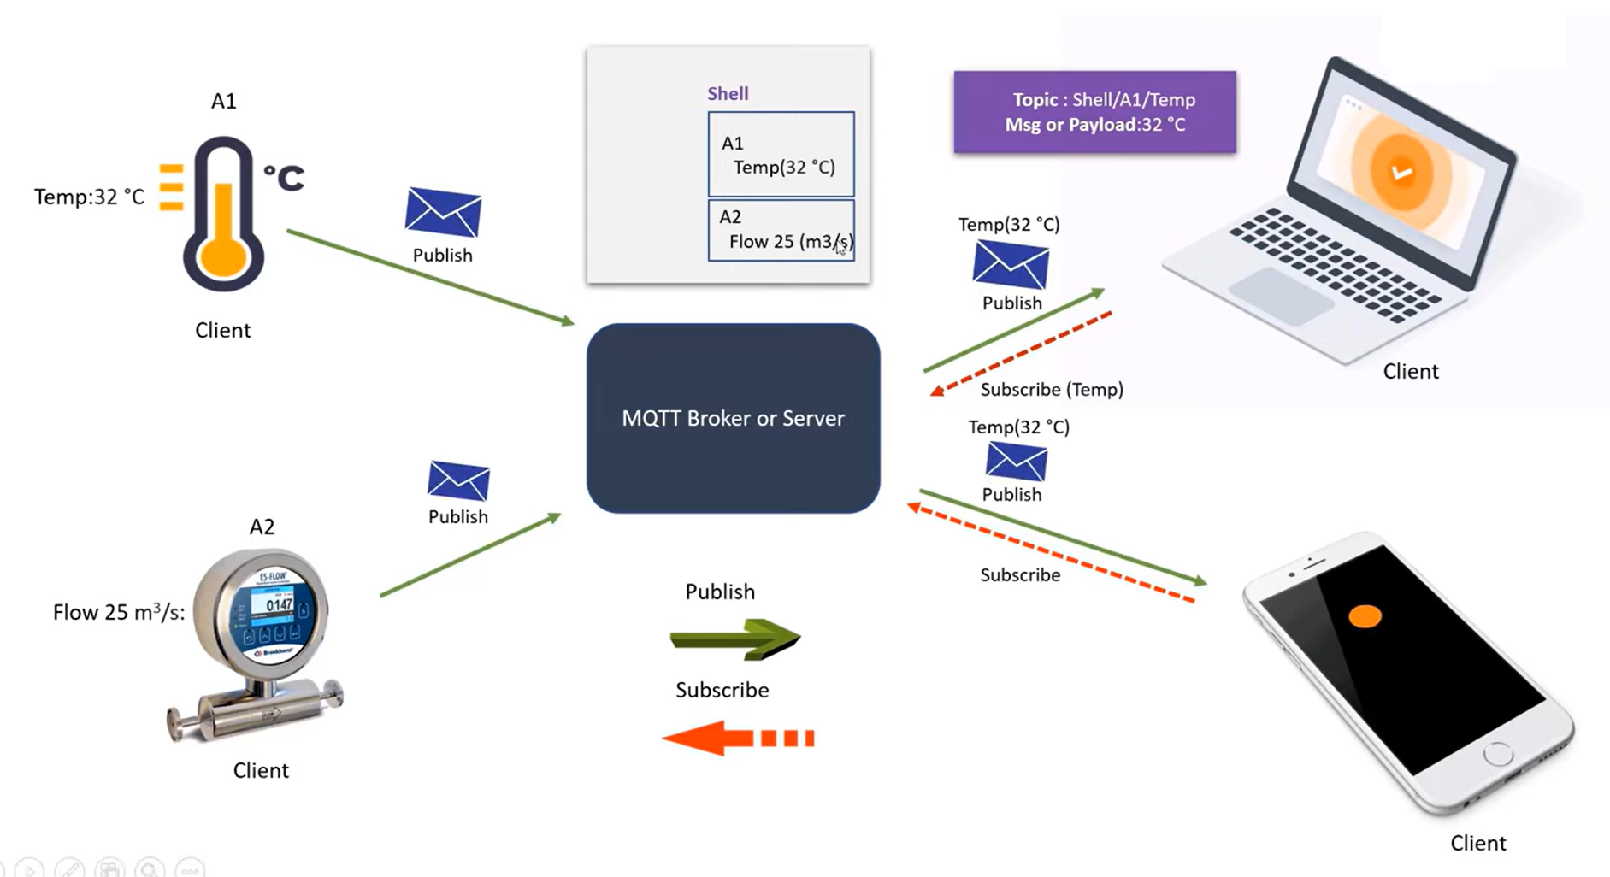
Publisher
Subscriber
Publisher
Subscriber

Slide 47
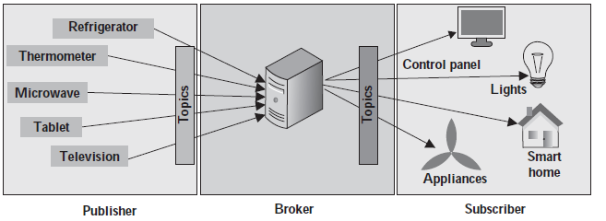
MQTT operation and its stakeholders

Slide 48
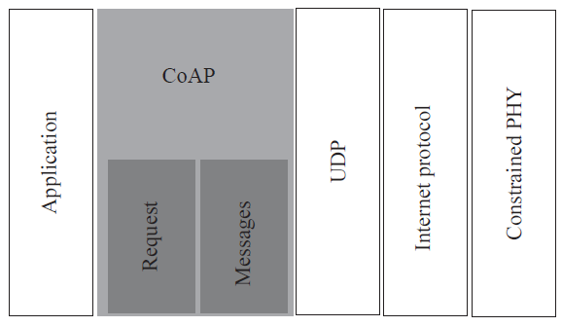
CoAP (Constrained Application Protocol) is a specialized web transfer protocol designed for use with constrained nodes and networks in the Internet of Things (IoT).
Confirmable (CON): Messages that require acknowledgment from the recipient. If no acknowledgment is received, the message is retransmitted.
Non-confirmable (NON): Messages that do not require acknowledgment, useful for scenarios where delivery is not critical, like periodic sensor updates.

Slide 49
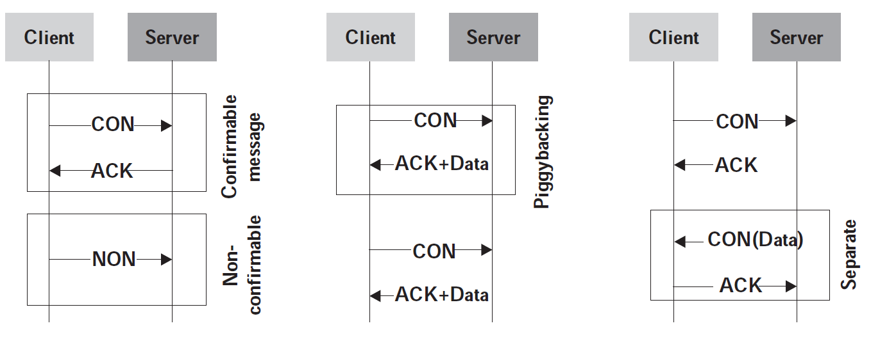
1. CON and NON messages
2. Piggyback messages
3. Seperate messages

Slide 50
AMQP (Advanced Message Queuing Protocol) is an open standard protocol for messaging between systems or applications. It enables message-oriented middleware and supports a wide range of messaging patterns, including point-to-point and publish-subscribe.
AMQP supports multiple messaging patterns, including:
Point-to-Point: One sender sends messages to one receiver.
Publish-Subscribe: One sender sends messages to multiple receivers (subscribers) via topics or queues.
Routing: Messages can be routed based on their content or headers, allowing for complex message distribution scenarios.
Request-Response: A pattern where a request message is sent and a response is awaited.

Slide 51
Publisher
Subscriber

Slide 52
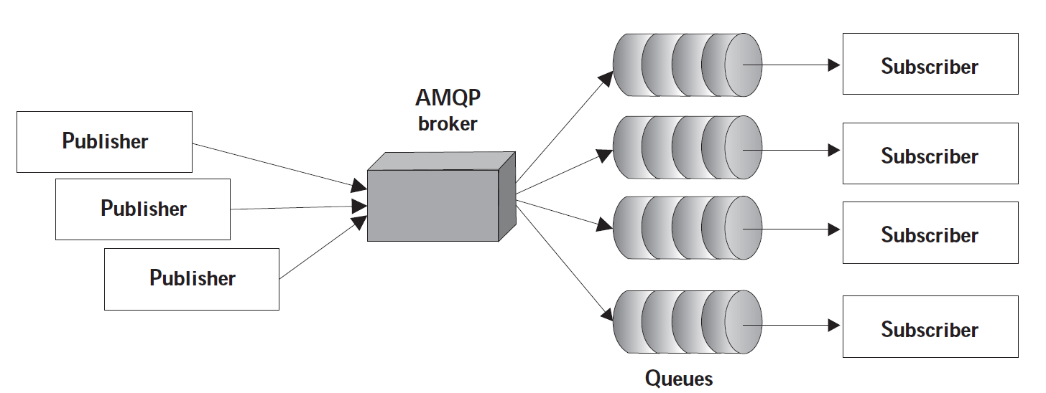
AMQP components and their relationships

Slide 53
There are 9 frame types in AMQP:
(i) Open: responsible for opening the connection between peers.
(ii) Begin: responsible for setup and control of messaging sessions between peers.
(iii) Attach: responsible for link attachment.
(iv) Transfer: responsible for message transfer over the link.
(v) Flow: responsible for updating the flow control state.
(vi) Disposition: responsible for updating of transfer state.
(vii) Detach: responsible for detachment of link between two peers.
(viii) End: responsible for truncation of a session.
(ix) Close: responsible for closing/ending a connection.

Slide 54
SOAP (Simple Object Access Protocol)
SOAP (Simple Object Access Protocol) is a message protocol that enables the distributed elements of an application to communicate.
SOAP can be carried over a variety of standard protocols, including the web-related Hypertext Transfer Protocol (HTTP).
Simple Object Access Protocol, as a specification, defines SOAP messages that are sent to web services and client applications. SOAP messages are XML documents that are comprised of the following three basic building blocks:

Slide 55
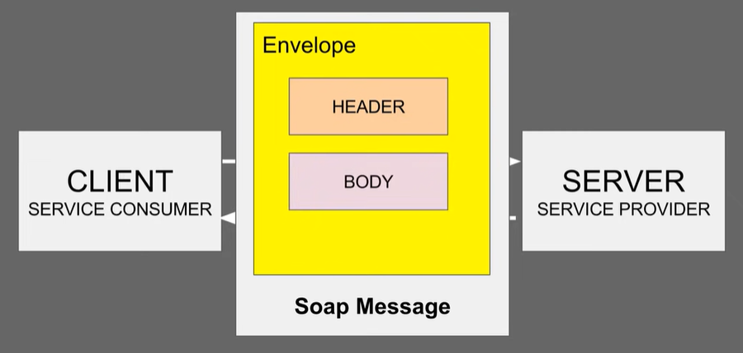
The SOAP Envelope encapsulates all the data in a message and identifies the XML document as a SOAP message.
2. The Header element contains additional information about the SOAP message. This
information could be authentication credentials, for example, which are used by the calling
application.
3. The Body element includes the details of the actual message that need to be sent from the web
service to the calling application. This data includes call and response information.

Slide 56

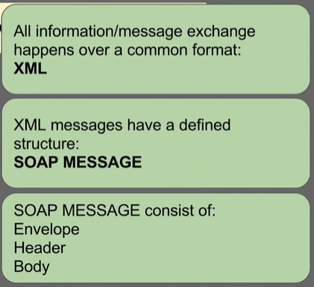
SOAP requests are easy to generate and process responses. First, a request for a service is generated by a SOAP client using an XML document.
Next, a SOAP client sends the XML document to a SOAP server. When the server receives the SOAP message, it sends the message as a service invocation to the requested server-side application.
A response containing the requested parameters, return values and data for the client is returned first to the SOAP request handler and then to the requesting client.
Both SOAP requests and responses are transported using Hypertext Transfer Protocol Secure (HTTPS) or a similar protocol like HTTP.

Slide 57
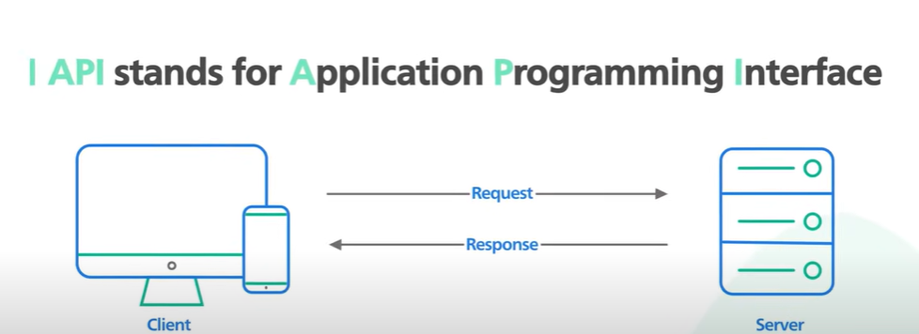
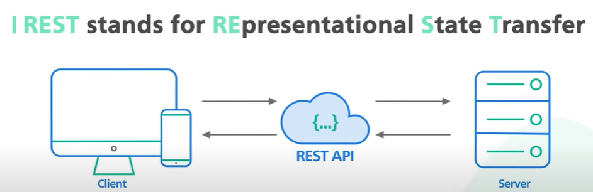
REST (Representational state transfer)
HTML, XML, or JSON

Slide 58
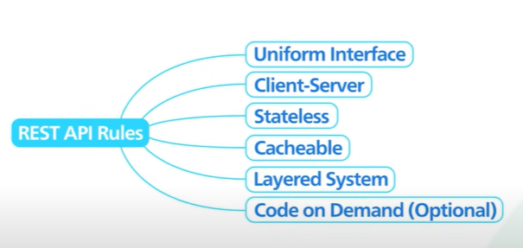

Slide 59
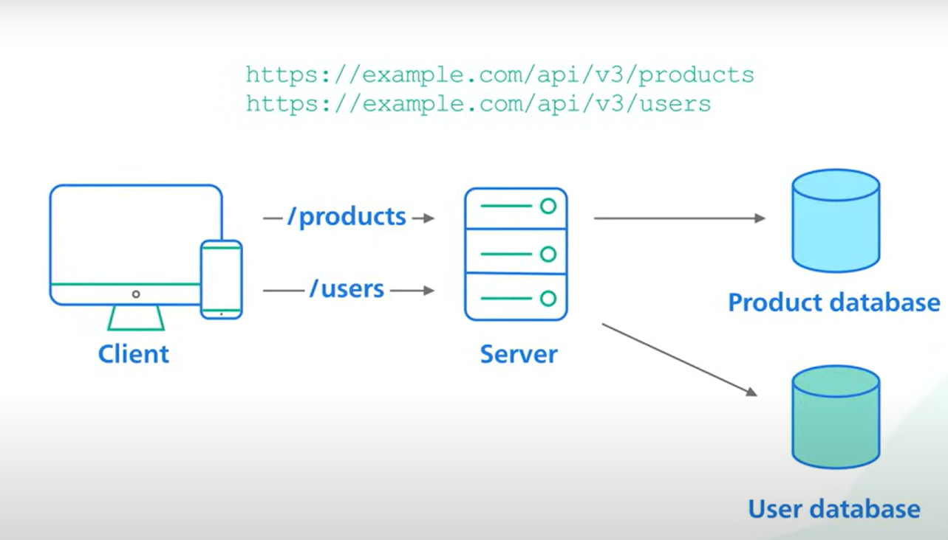

Slide 60
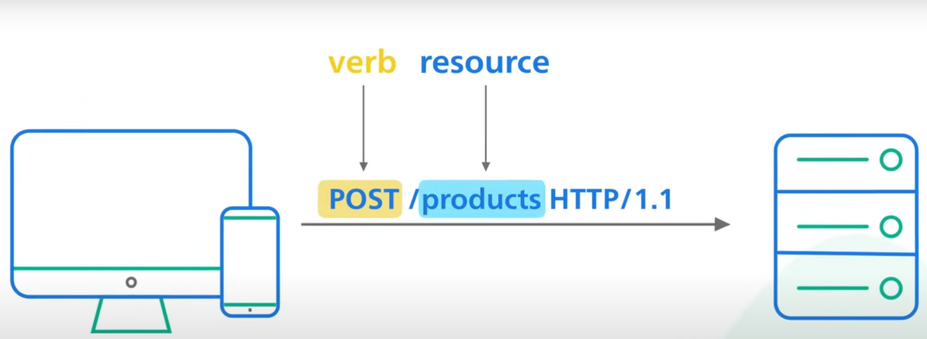

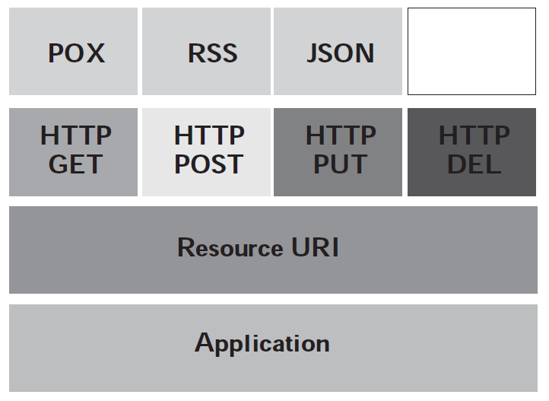
Client
Server
GET /users/123 : Retrieve user with ID 123.
POST /users : Create a new user.
PUT /users/123 : Update user with ID 123.
DELETE /users/123: Delete user with ID 123.
Representation of the REST style and its components

Slide 61
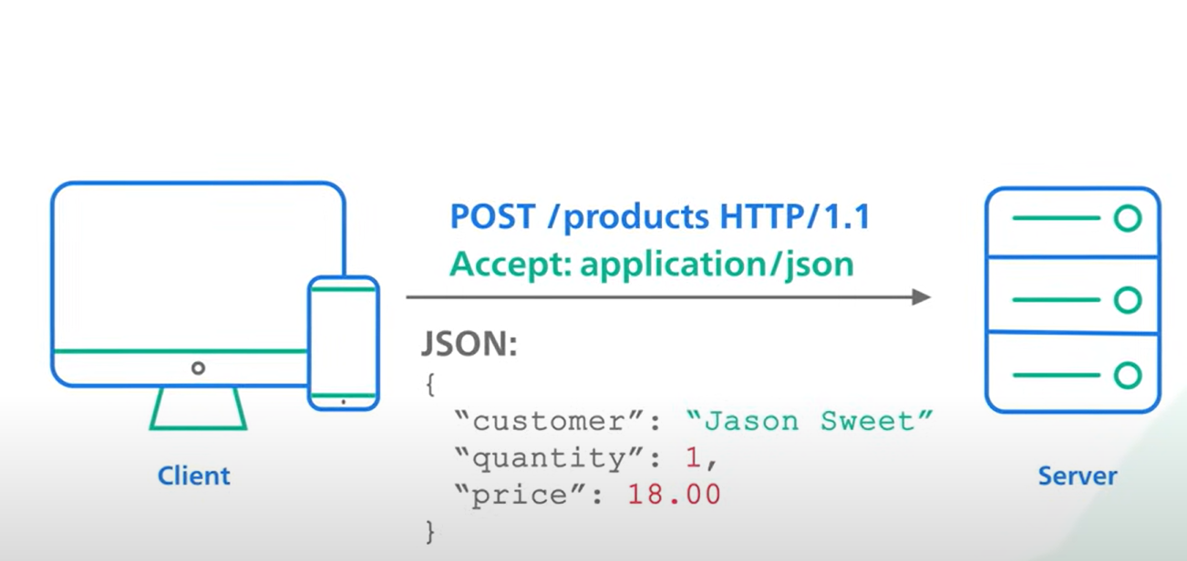
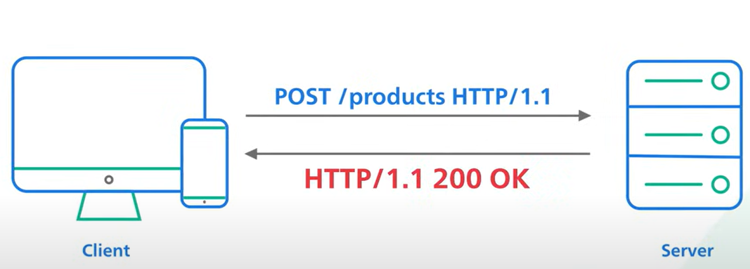

Slide 62
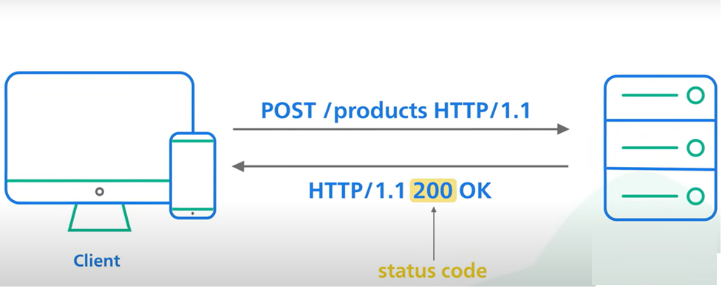
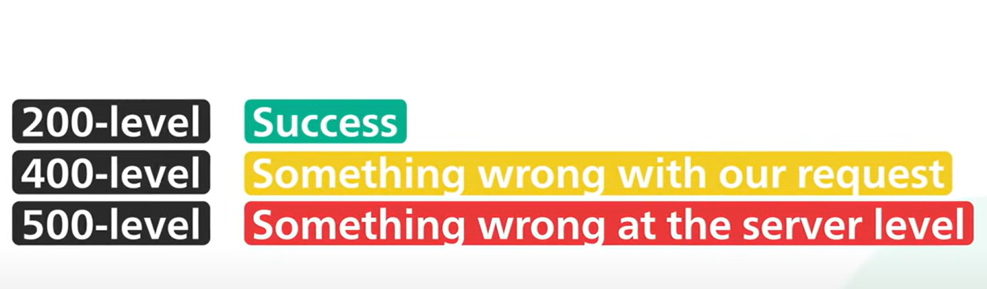
Client
Server

Slide 63
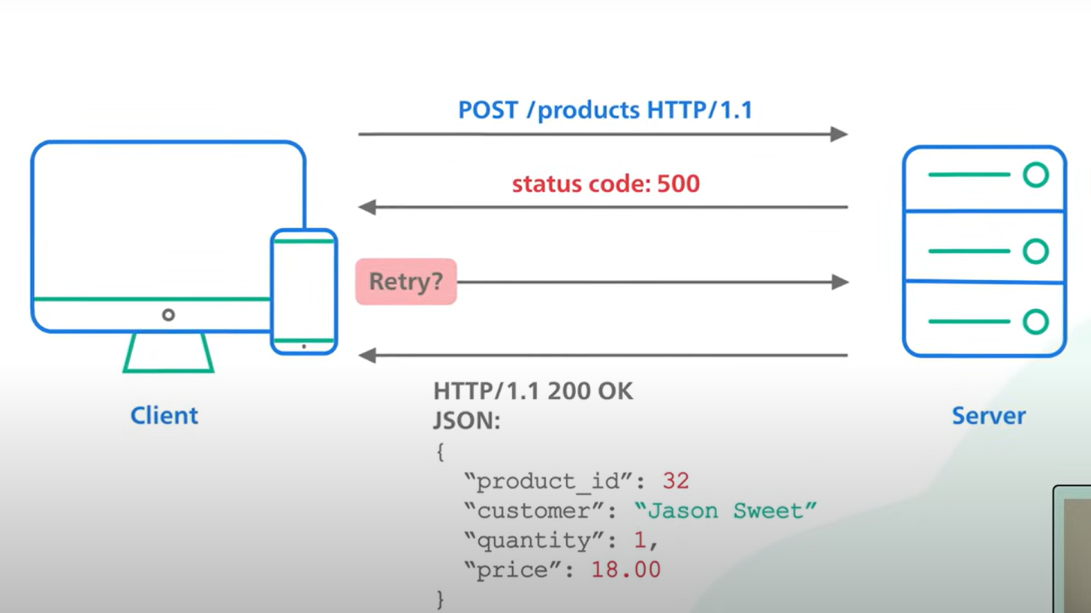

Slide 64
RESTful systems are guided by six general constraints, which define and restrict the process of client–server interactions and requests–responses. These guidelines increase system performance, scalability, reliability, modifiability, portability, and visibility. All RESTful systems have to adhere to these six guidelines strictly:
Statelessness: The statelessness of the client–server communication prevents the storage of any contextual information of the client on the server. Each client request has to be self-sufficient in informing its responders about its services and session state. This is done by including the possible links for new state transitions within the representation of each application state. Generally, upon detecting pending requests, the server infers that the client is in a state of transition.
Uniform Interface: Each part or component of a RESTful system must evolve independently as a result of the decoupling of architectures and its simplification.
Cacheability: The responses have to be implicitly, or in some cases, explicitly clear on whether they have to be cached or not. This helps the clients in retaining the most updated data in response to requests. Caching also reduces the number of client–server interactions, thereby improving the performance and scalability of the system as a whole.
Client–server Architecture: The user–interface interactions should be separate from data storage ones. This would result in enhanced portability of user interfaces across multiple platforms. The separation also allows for the independent evolution of components, which would result in scalability over the Internet across various organizational domains.

Slide 65
Layered System: The client in RESTful services is oblivious to the nature of the server to which it is connected: an end point server or an intermediary server. The use of intermediaries also helps in improving the balancing of load and enhancing security measures and system scalability.
Code on Demand: This is an optional parameter. Here, the functionality of clients can be extended for a short period by the server. For example, the transfer of executable codes from compiled components.

Slide 68
Role Flexibility: FFDs have greater flexibility and can take on multiple roles within the network, while RFDs are limited to being simple End Devices.
Networking Capabilities: FFDs can participate in routing and network management, whereas RFDs rely on FFDs for communication with the rest of the network.
Energy Usage: RFDs are more energy-efficient, focusing on minimal communication and power usage, while FFDs may consume more power due to their extended functionality.

Slide 69
802.15.4 standard is specifically designed for Low data Rate Wireless Personal Area Networks
Nodes can communicate with lower data rate

